Slide 1
Alojz Gomola
Self-Separation Property
14th January 2019
UAS Separation from threats, Guaranty of safety

Slide 2




Introduction to Sense & Avoid
UAS
Adversary
Intruder
Static obstacle
Notes:
Our main focus is to keep UAS safe while doing its business ,
There are Intruder planes which tell us where we are and tries to not harm UAS
Next are not so kind Adversaries which do not care about UAS nor Active avoidance
Then there is the greatest enemy of UAS, everlasting ground and its related obstacles.

Slide 3
Introduction to Sense & Avoid
Field of Vision
(FOV)
Obstacle
Waypoint
$$W_{1}$$
Avoidance execution
Reactive obstacle avoidance
Obstacle detection
Waypoint
$$W_{3}$$
Waypoint
$$W_{2}$$
Planned path
Notes:
UAS is flying some mission given by set of navigation waypoints
Obstacle enters into Field of Vision,
Our algorithm for “Reactive” obstacle is triggered.
UAS will avoid the danger and safely finishes the mission

Slide 4
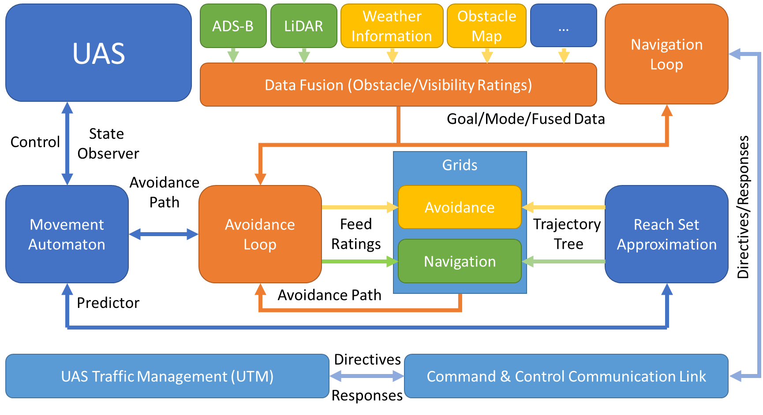
There is an Obstacle Avoidance Framework …

Slide 5
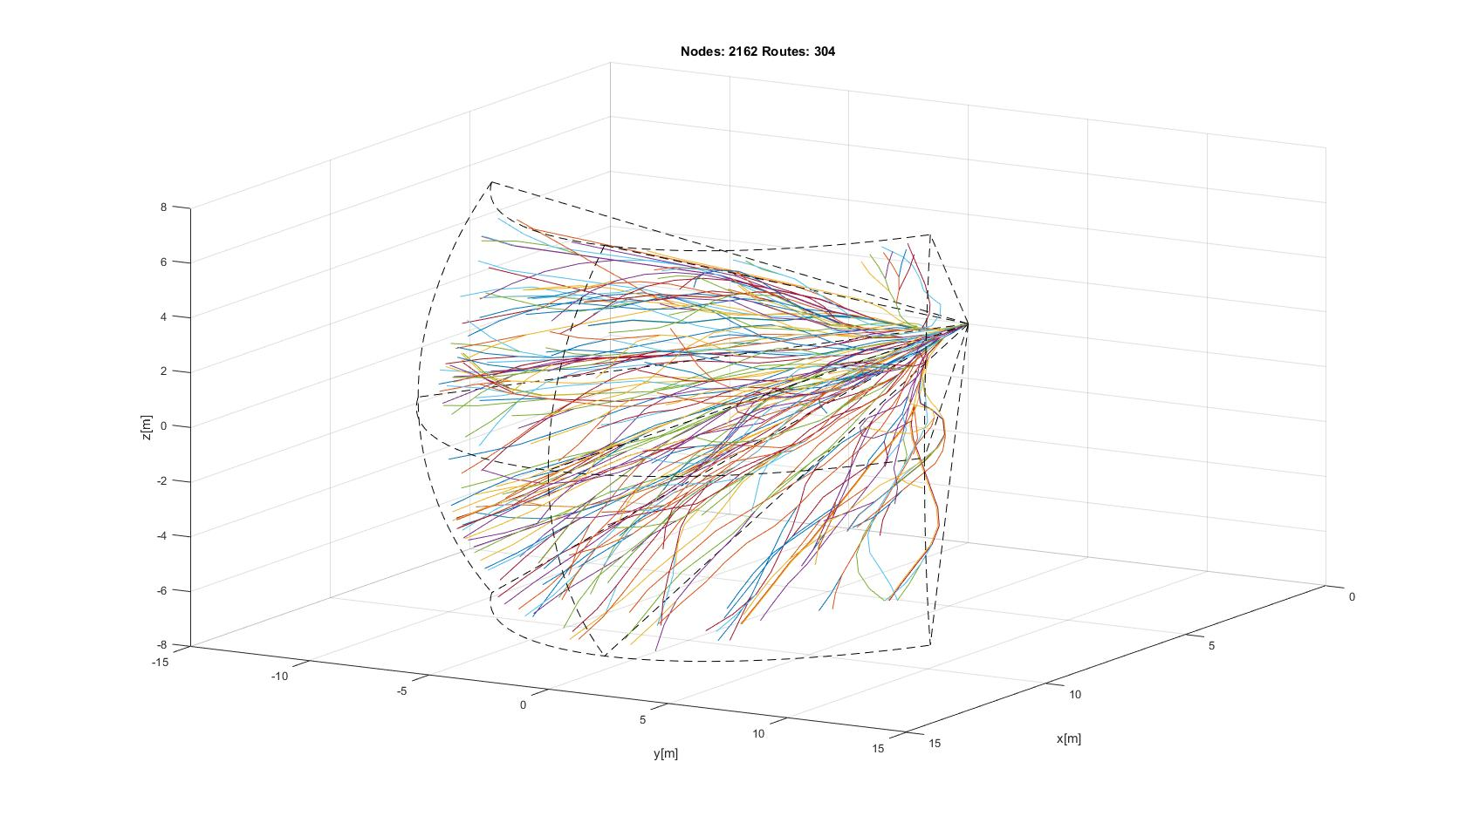
Combined Reach Set Example
Notes:
Combined or Harmonic spread contains some chaotic routes and guarantees direct and smooth lines in grid

Slide 6
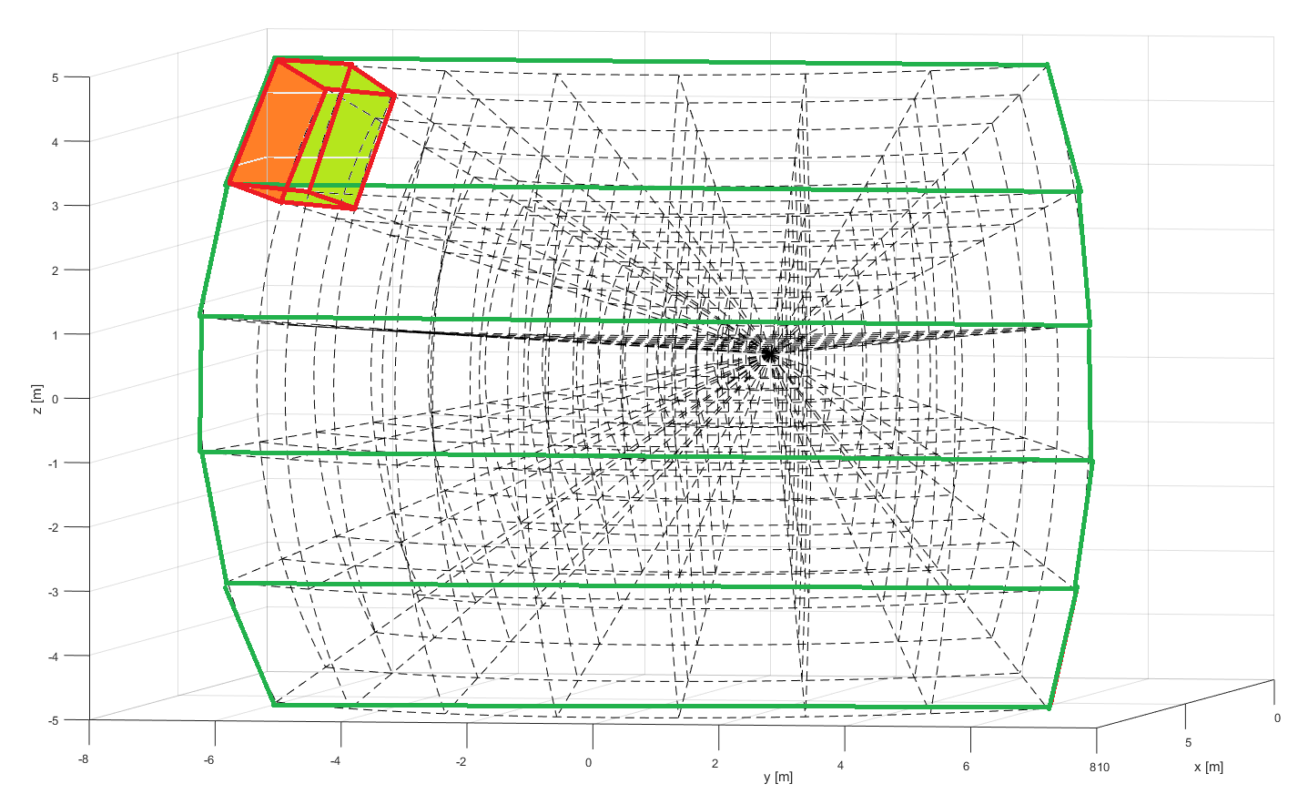
Avoidance Grid Layout
Layers
Cell (10,1,1)
Top
Top-Middle
Horizontal layers
UAS position
Middle
Bottom-middle
Bottom

Slide 7
Avoidance Run: Select optimal One Trajectory for One Time-Frame under Consolidated Threat
Notes:
The framework have matured beyond that basic functionality,
Now I will show some advanced examples

Slide 8
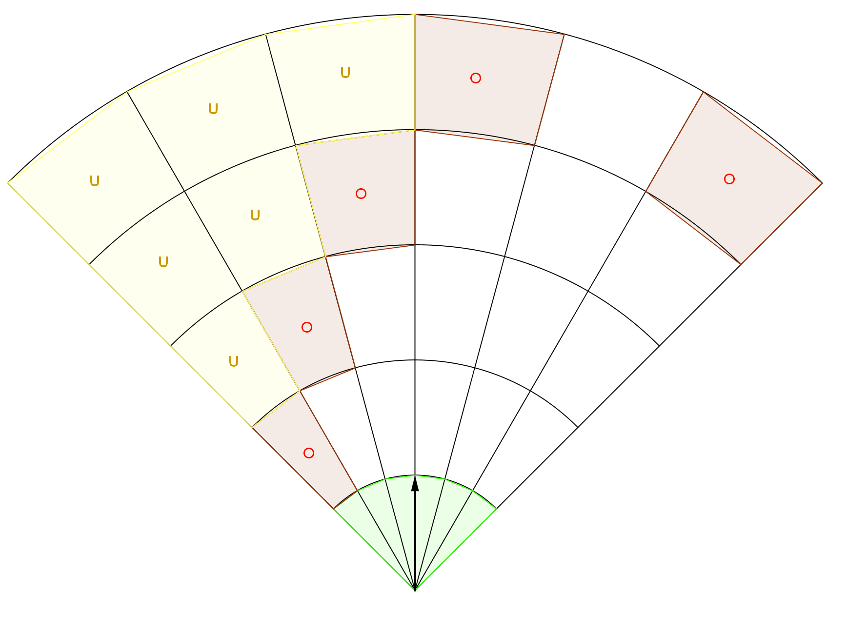
Avoidance Run – Threat Evaluation

Slide 9
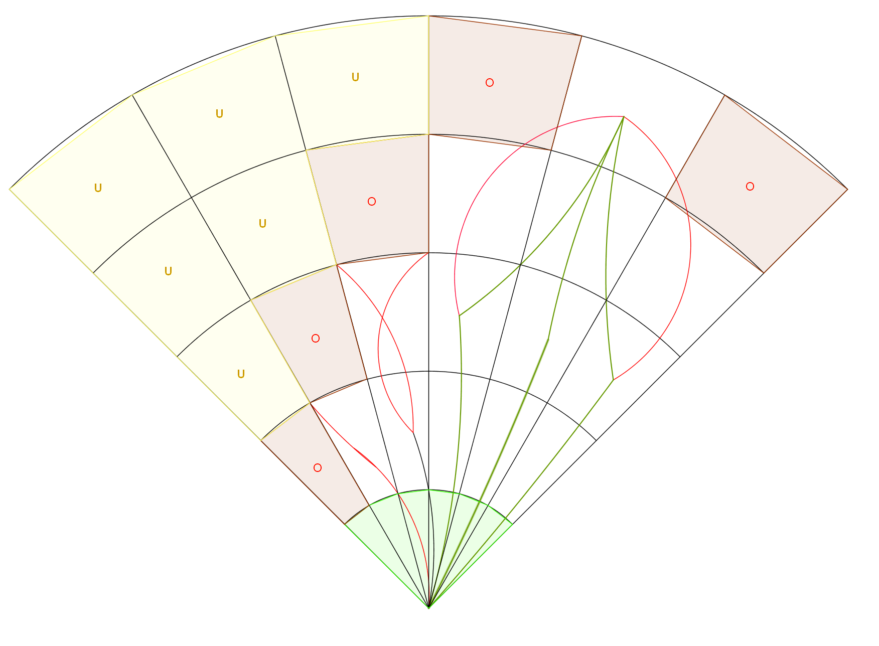
Avoidance Run – Reach Set Trimming

Slide 10
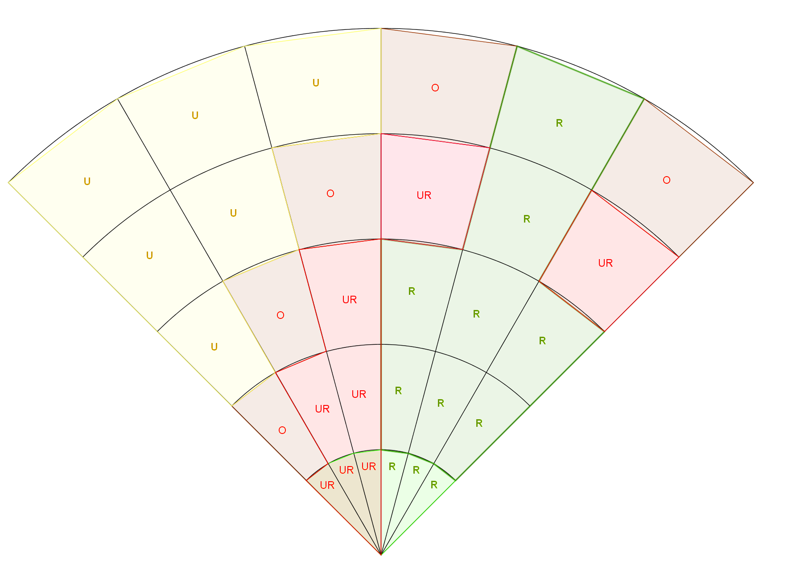
Avoidance Run – Reachable Cells

Slide 11
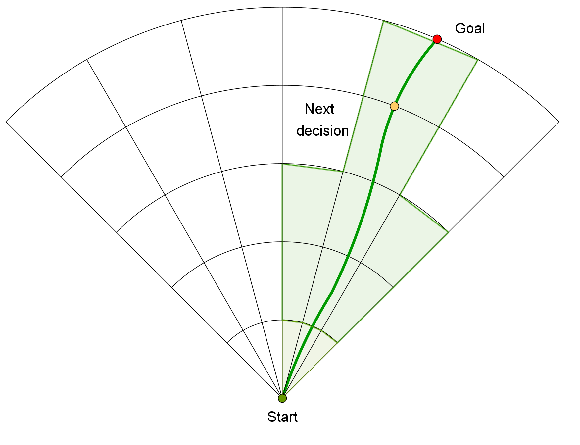
Avoidance Run – Candidate Trajectory

Slide 12
Threat hierarchy: avoiding static obstacles is Must, cooperating with Intruders is Courtesy, not breaking hard constraints is Manners, not breaking soft constraints is Nice.
Notes:
The framework have matured beyond that basic functionality,
Now I will show some advanced examples

Slide 13
Threat to UAS – Charted threats/groups
Type
Group
Mild weather zones
Soft constraints
Geo-fencing warning zones
Airspace protected zones
Severe weather zones
Hard constraints
THREAT
LEVEL
Airspace restrictions
Geo-fencing zones
Birds
Intruders
Unmanned aviation
Manned aviation
Powerlines, air structures
Static obstacles
Man-made Structures
Natural Structures
Ground

Slide 14
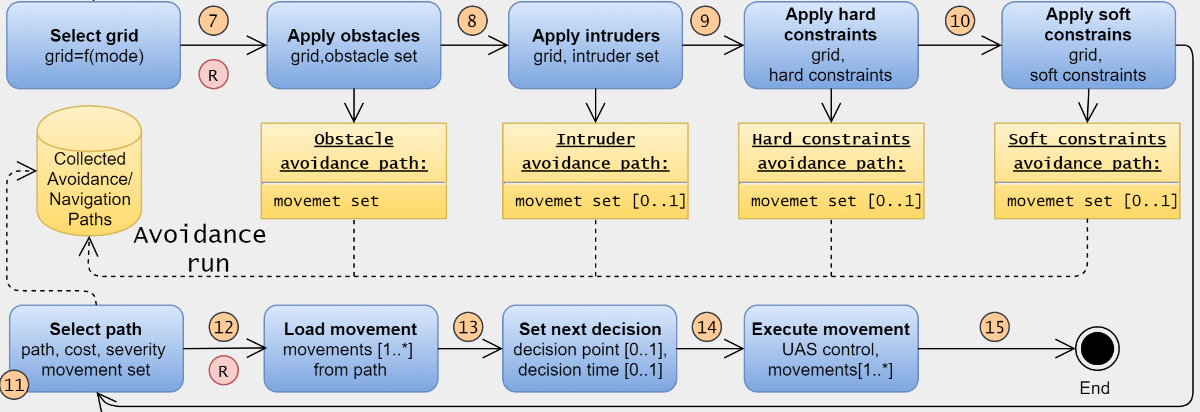
Threat Evaluation Process
Avoidance Run is run for each threat level:
1st Static Obstacles – last resort – trajectory guaranteed
2nd Static Obstacles + Intruders
3rd Static Obstacles + Intruders + Hard Constraints
4th Static Obstacles + Intruders + Hard Constraints + Soft Constraints
Navigation Loop snippet:

Slide 15
Navigation Run: over multiple Decision Frames under multiple Threat levels create safe joined Trajectory to solve the Mission
Notes:
The framework have matured beyond that basic functionality,
Now I will show some advanced examples

Slide 16
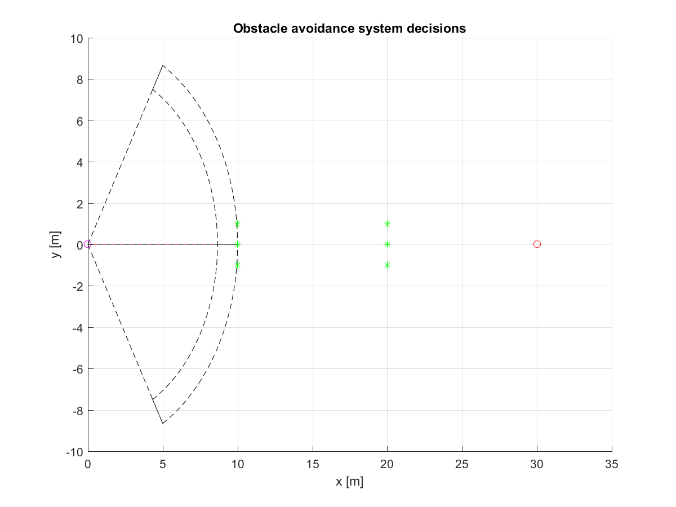
Navigation Run – 1st Decision
Avoidance grid A(t1)
UAS position
Goal
O_1
O_2
Field Of Vision

Slide 17
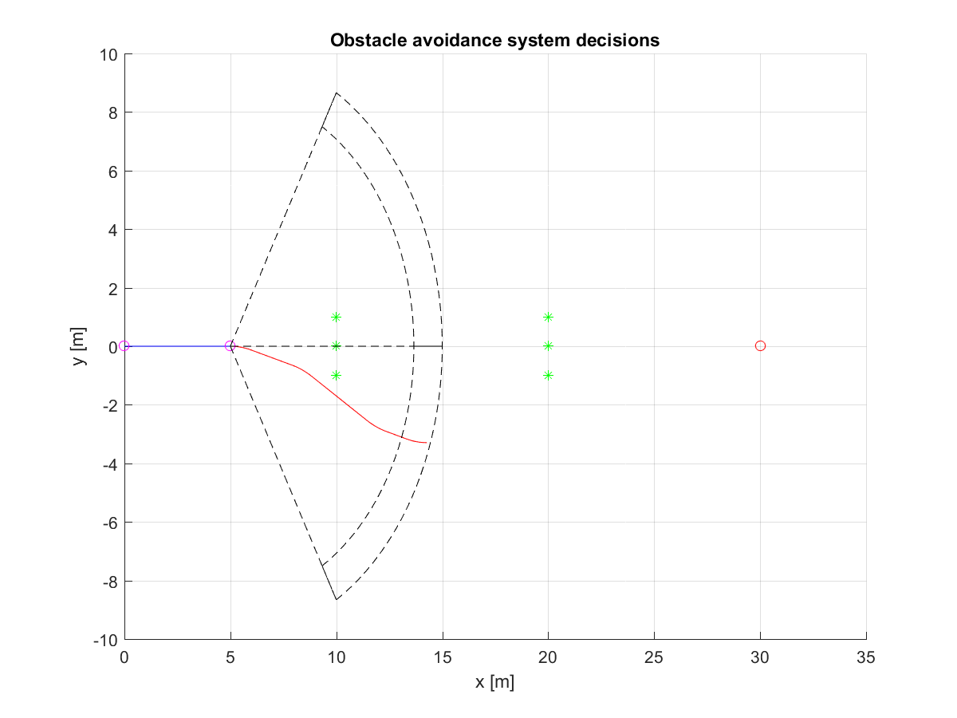
Navigation Run – 2nd Decision
Avoidance grid A(t2)
I flew this
O_1
O_2
I plan this
Next decision here

Slide 18
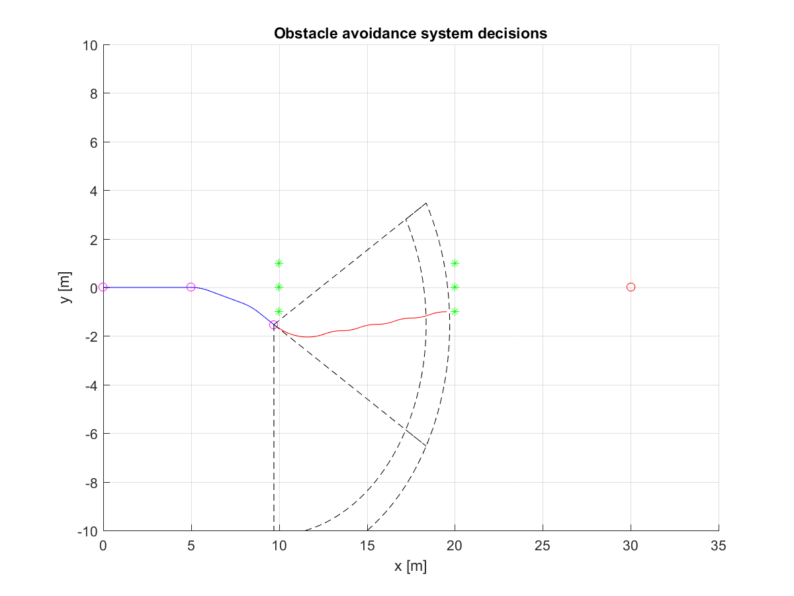
Navigation Run – 3rd Decision
Avoidance grid A(t3)
O_1
O_2
I make me next decision here

Slide 19
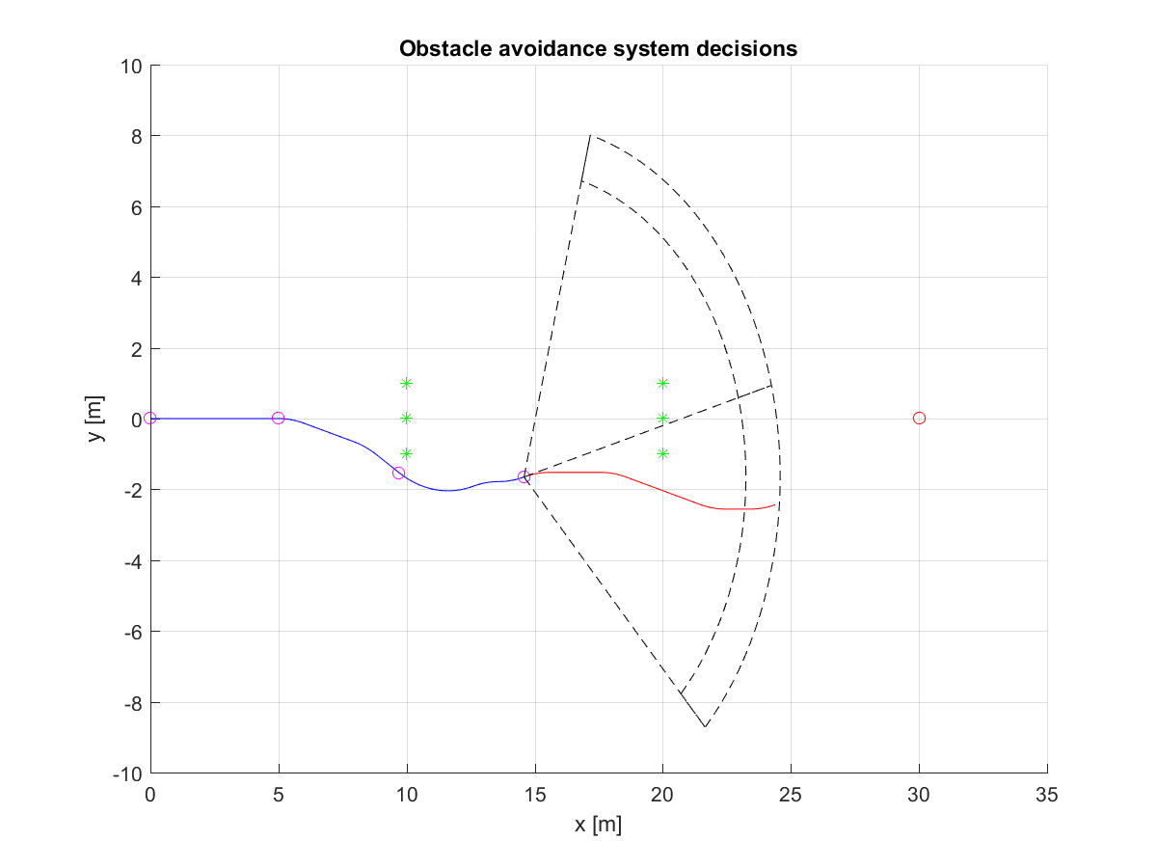
Navigation Run – 4th Decision
Avoidance grid A(t4)
O_1
O_2
I make me next ecision here

Slide 20
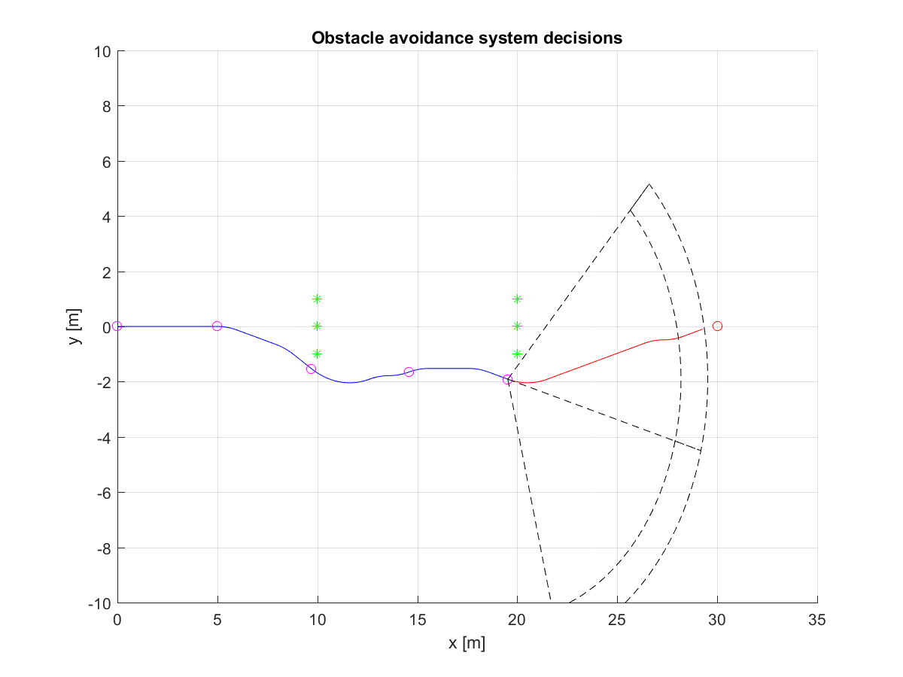
Navigation Run – 5th Decision
Avoidance grid A(t5)
O_1
O_2
Next decision here

Slide 21
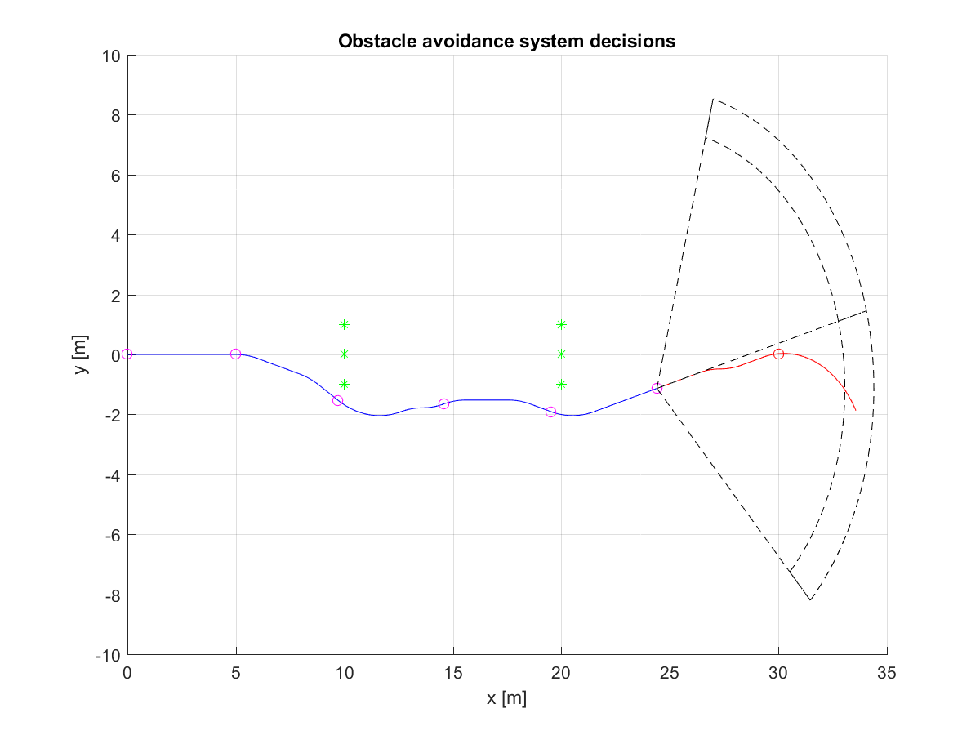
Navigation Run – 6th Decision
Avoidance grid A(t6)
O_1
O_2
I make me next ecision here

Slide 22
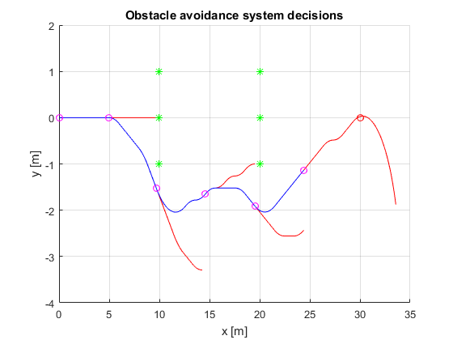
Navigation Run – Trajectory Buildup
O_1
O_2
Decision points
Planned
Executed

Slide 23


Test Framework Setup
Navigation Loop
Data Fusion
ADS-B
Situation Assessment
Events
Triggers
LiDAR
Goal Waypoint
Weather
Directives
Changes
Directives
Avoidance Run
Avoidance Grid
Map
Avoidance Trajectory
Restrictions
Reach Set
Probabilities
Notes:
Navigation Loop Provides goal waypoint from mission plan
- taken from other work
- very simple
Data fusion is providing probabilistic assessment of situation from following data sources:
- ADS-B for intruders
Lidar for static obstacles and adversaries
Weather constraints
Control authority directives
Map of obstacles
Restrictions – Geo fencing and others static restritions
These data sources are basically a static and dynamic constraints for UAS
Situation assessment – own module
- Outside Events - ex. new intruder arrival
- Internal Triggers – ex. reach of decision point
- Valid Directives – ex. Geofencing around Honeywell CZ27 building
- Probabilistic situation changes are evaluated – ex increase of danger of bird collision …
It triggers a Avoidance Run
Avoidance Run (Own work) does what I described just not …

Slide 24
Examples: Maze Solver Storm Avoidance
Notes:
The framework have matured beyond that basic functionality,
Now I will show some advanced examples

Slide 25
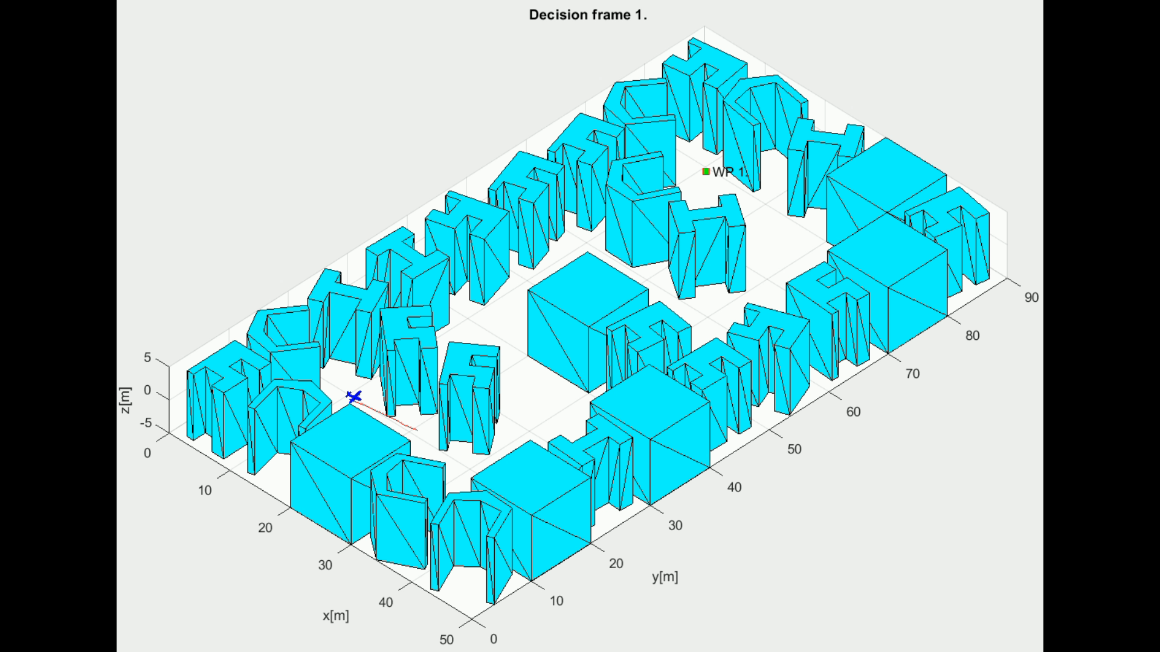
Example: Simple maze
Notes:
The blue plane is flying in Cyan city,
Trying to reach waypoint marked as green square,
The red line is planned trajectory which is changing every decision frame,
As you can see navigation can solve heavily constrained problem with ease

Slide 26
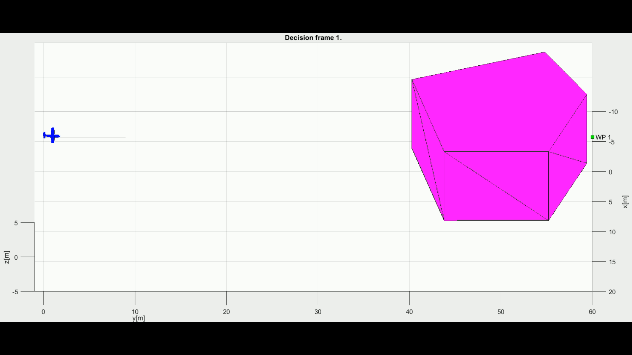
Example: Storm
Notes:
Well that was for static obstacles, what about moving ones much bigger than our little plane,
The blue plane is trying to avoid a storm
Framework can also comprehend moving obstacles and constraints

Slide 27
Self-Separation: ability to generate trajectory to keep UAS separated from the leveled threat
Notes:
The framework have matured beyond that basic functionality,
Now I will show some advanced examples

Slide 28
TODO
The static obstacles is must – they will not avoid us ☺
The other is depending on maneuvering capability

